Slide 1

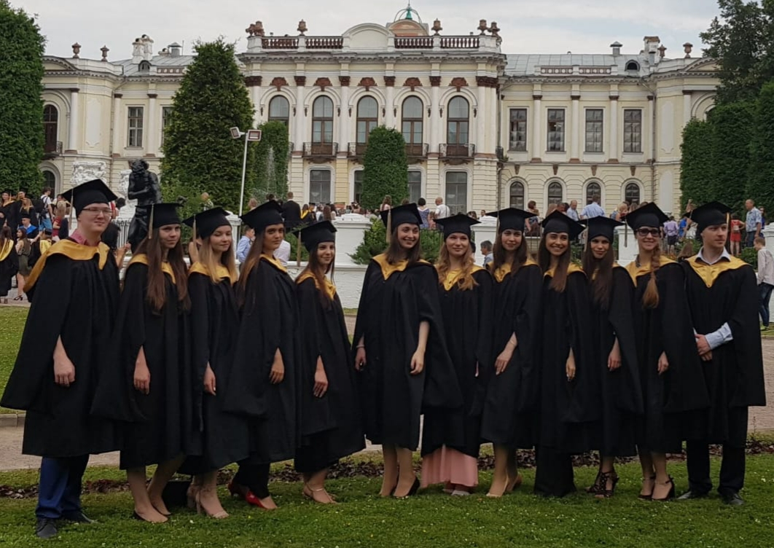

Russian State Agrarian University - Moscow Timiryazev Agricultural Academy
Institute of Economics and management in agribusiness
Speaker:
Vadim V. Demichev
PhD in Economics, Associate Professor
Moscow, October 15th, 2020

Slide 2

Institute of Economics and management in agribusiness
The Institute was founded on October 9, 1922.
However, some of the departments are already more than a hundred years old.

Slide 3
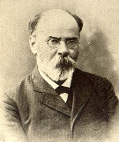
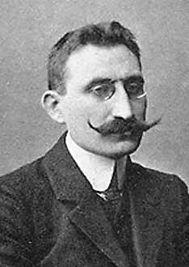
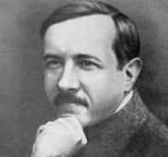
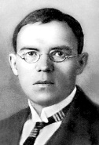
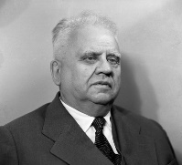
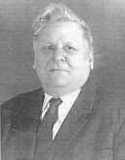
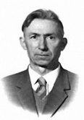
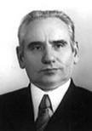
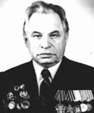
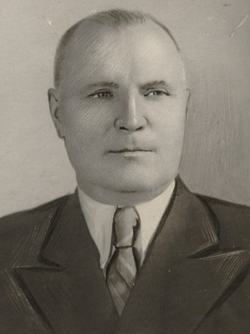
Institute of Economics and management in agribusiness
The Institute keeps traditions and develops scientific and pedagogical schools founded by famous scientists with a world name:
A. F. Fortunatov
Galagan A.M.
Chayanov A.V.
N. D. Kondratyev
V. S. Nemchinov
Loza G.M.
S. S. Sergeev
Sinyukov M.I.
Dobrynin V.A.
I. S. Kuvshinov

Slide 4
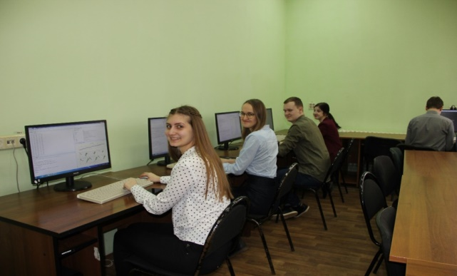
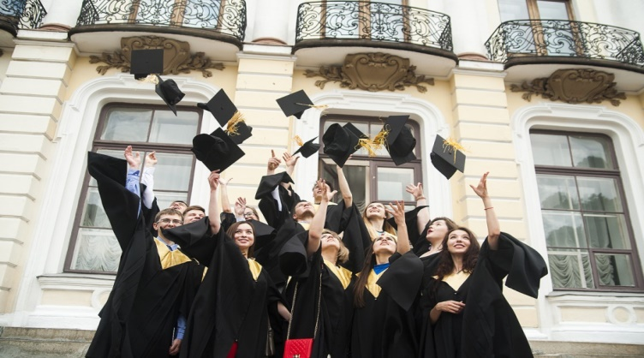
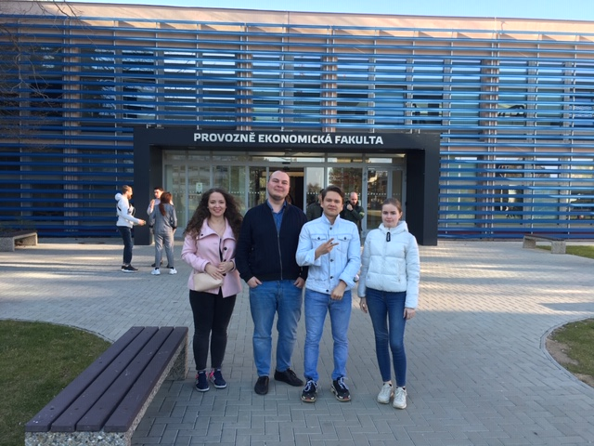
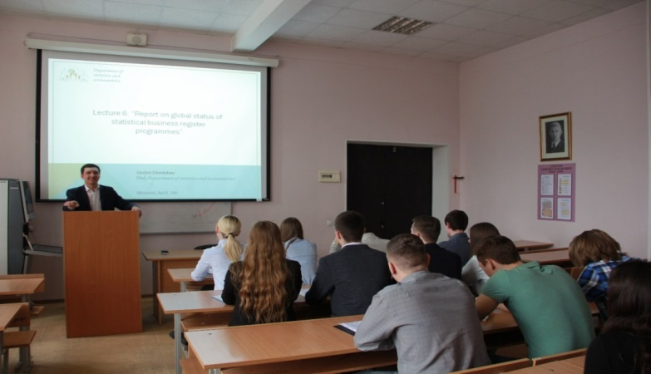
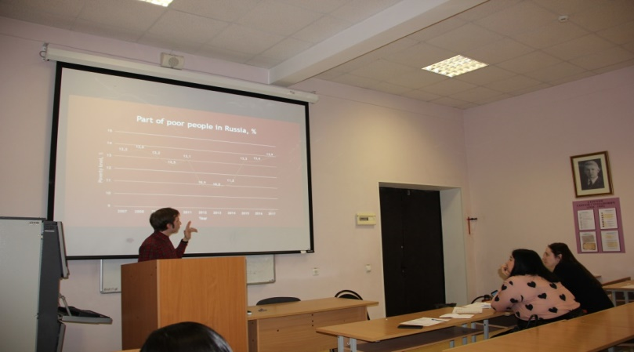
Institute of Economics and management in agribusiness
Today the Institute is 173 teachers and 1214 students

Slide 5
Institute of Economics and management in agribusiness
Departments:
- Marketing
World Economy
Organization of production
Economic Theory
Management
Economy
Accounting
Mathematics
Taxation and financial law
Applied Informatics
Statistics and econometrics
Finance
Economic security, analysis and audit

Slide 6
Institute of Economics and management in agribusiness
B.Sc. programs
Economy
Accounting, analysis and audit
Management
Logistics
Information systems and technologies
Information technology data analysis
Finance
Enterprise Economy
Applied Informatics
Applied Informatics in Economics
World Economy
Marketing
Production management

Slide 7
Institute of Economics and management in agribusiness
M.Sc. programs
Economy
Accounting accounting and taxation
Management
Agricultural trade and marketing
Information systems and technologies
Information systems and technologies in business intelligence
Economics and Management
Corporate accounting and taxation
Applied Informatics
Information systems in logistics
Innovative development of the agro-industrial complex economy
Project management
Production management
Digital technologies in the economy

Slide 8
















Development of strategic partnership
Ministries and government services
Россельхознадзор
Agribusiness
«Агрохолдинг АгроПром комплектация»
«Микоян»
Клинский
мясокомбинат
ГК «Черкизово»
«РоссельхозБанк»
«ЭкоНива»
«Останкинский Молочный Комбинат»
«Вимм-Билль-Данн»
«Зеленоградское»

Slide 9










Development of strategic partnership
International scientific and educational programs and projects
Slovakia
Czech Republic
Germany
China
Netherlands
Iran
Kazakhstan
Uzbekistan
Tajikistan

Slide 10





Institute of Economics and management in agribusiness
Department statistics and econometrics
(New areas of research):
Big data in agriculture
Digital economy of agriculture
Sustainable development of agriculture and rural areas
Inclusive economic growth

Slide 11
Institute of Economics and management in agribusiness
Thank you for your attention!
Contacts:
Head of Institute of Economics and management in agribusiness, Doctor of Economic Sciences, Professor:
Lyudmila Ivanovna Horuzhy, +7 (499)976-12-50, hli@rgau-msha.ru
Speaker, PhD in Economics, Associate Professor:
Vadim Vladimirovich Demichev, + 7 (926) 826 25 23, demichev_v@rgau-msha.ru

